Slide 1
Ai-grc Metrix
CAPSTONE PROJECT
Presented By:
Student Name – Tanya Priya
College Name – J.D Women's College
Department – Mathematics
AICTE ID – STU6a572960ed77a1784097120

Slide 2
OUTLINE
Problem Statement
Proposed System/Solution
System Development Approach
Algorithm & Deployment
Result
Conclusion
Future Scope
References

Slide 3
Problem Statement
Organizations handle large amounts of security, privacy, risk, and compliance information, making GRC audits difficult and time-consuming to manage manually.
It can also be challenging to identify vulnerabilities and understand which regulatory requirements or security controls are affected.
A simpler and more automated approach is needed to assess risks and present compliance issues clearly.

Slide 4
Proposed Solution
AI-GRC Metrix is an AI-based GRC auditing system that analyses a company's security and data profile to identify potential risks and compliance gaps.​ The system evaluates the profile against multiple frameworks such as GDPR, DPDP Act, SOC 2, ISO 27001, and DORA.​ It generates an overall compliance score, risk posture, detailed findings, affected clauses or controls, and practical recommendations for addressing the identified issues.​
Data Collection / Input - The user provides the company's security, privacy, infrastructure, and third-party risk information through the audit configuration.​
Data Processing -​ The system analyses the company profile and maps the identified issues to relevant GRC frameworks and controls.​ ​
Risk Assessment - Each finding is assessed using likelihood and impact to calculate a risk score.​ ​
Regulatory Mapping - Identified issues are mapped to relevant clauses or controls under frameworks such as GDPR, DPDP Act, SOC 2, ISO 27001, and DORA.​
​Output - The system presents a compliance score, overall risk posture, findings by severity, and recommendations for improvement.​

Slide 5
System Approach
System Requirements
Python
Streamlit
Google Gemini API
Internet connection
Web browsers
Libraries Required​
Streamlit​
Google Generative AI / Gemini​
Python standard libraries​
Supporting libraries used for data processing and application logic​
System Approach​
Company Profile → AI Analysis → Risk Assessment → Framework Mapping → Findings & Recommendations​

Slide 6
Algorithm & Deployment
Algorithm Selection
Deployment
The system uses Generative AI to understand the company profile and identify potential GRC risks and compliance gaps.
NIST SP 800-30 risk assessment principles are used to evaluate risk based on likelihood and impact.
Data Input - The system takes a company's security, privacy, access control, backup, infrastructure, and third-party risk information as input.
Training Process - The application does not train a model on new data. Instead, the configured company profile is analysed using the selected AI model and predefined GRC framework information.
The application is deployed using Streamlit and can be accessed through a web browser.​
Prediction / Analysis Process - The AI analyzes the input, identifies possible compliance issues, maps them to relevant controls or clauses, and assigns severity based on likelihood and impact.​
Deployment - The application is deployed on Streamlit and can be accessed through a web browser.​

Slide 7
Result
The system successfully generated an automated GRC audit report from the provided company profile.
For the sample audit, the system reported:
Overall Compliance Health Score: 48%
Corporate Risk Posture: HIGH
Total Findings: 10
Critical Findings: 4
The audit also mapped findings across GDPR, DPDP Act, SOC 2, ISO 27001, and DORA, along with risk scores and recommendations.
The results provide a clear view of the organization's major compliance gaps and areas requiring immediate attention.

Slide 8
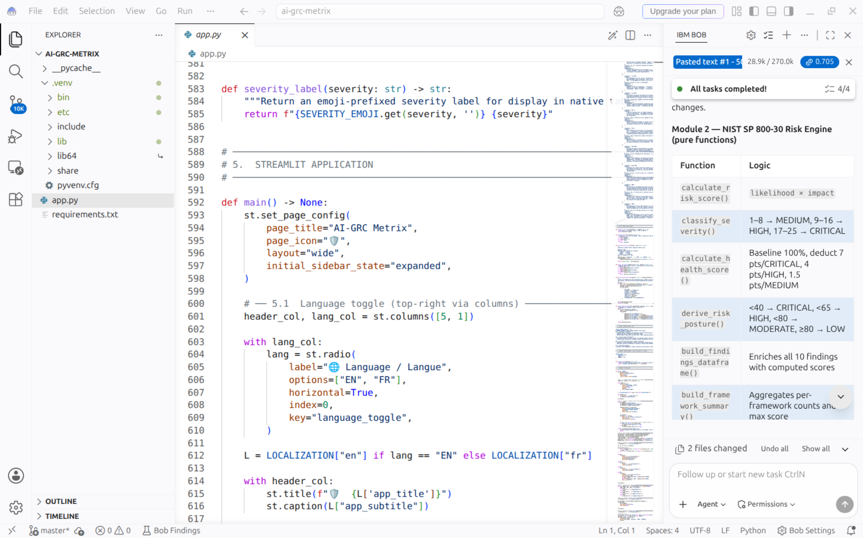
Result

Slide 9
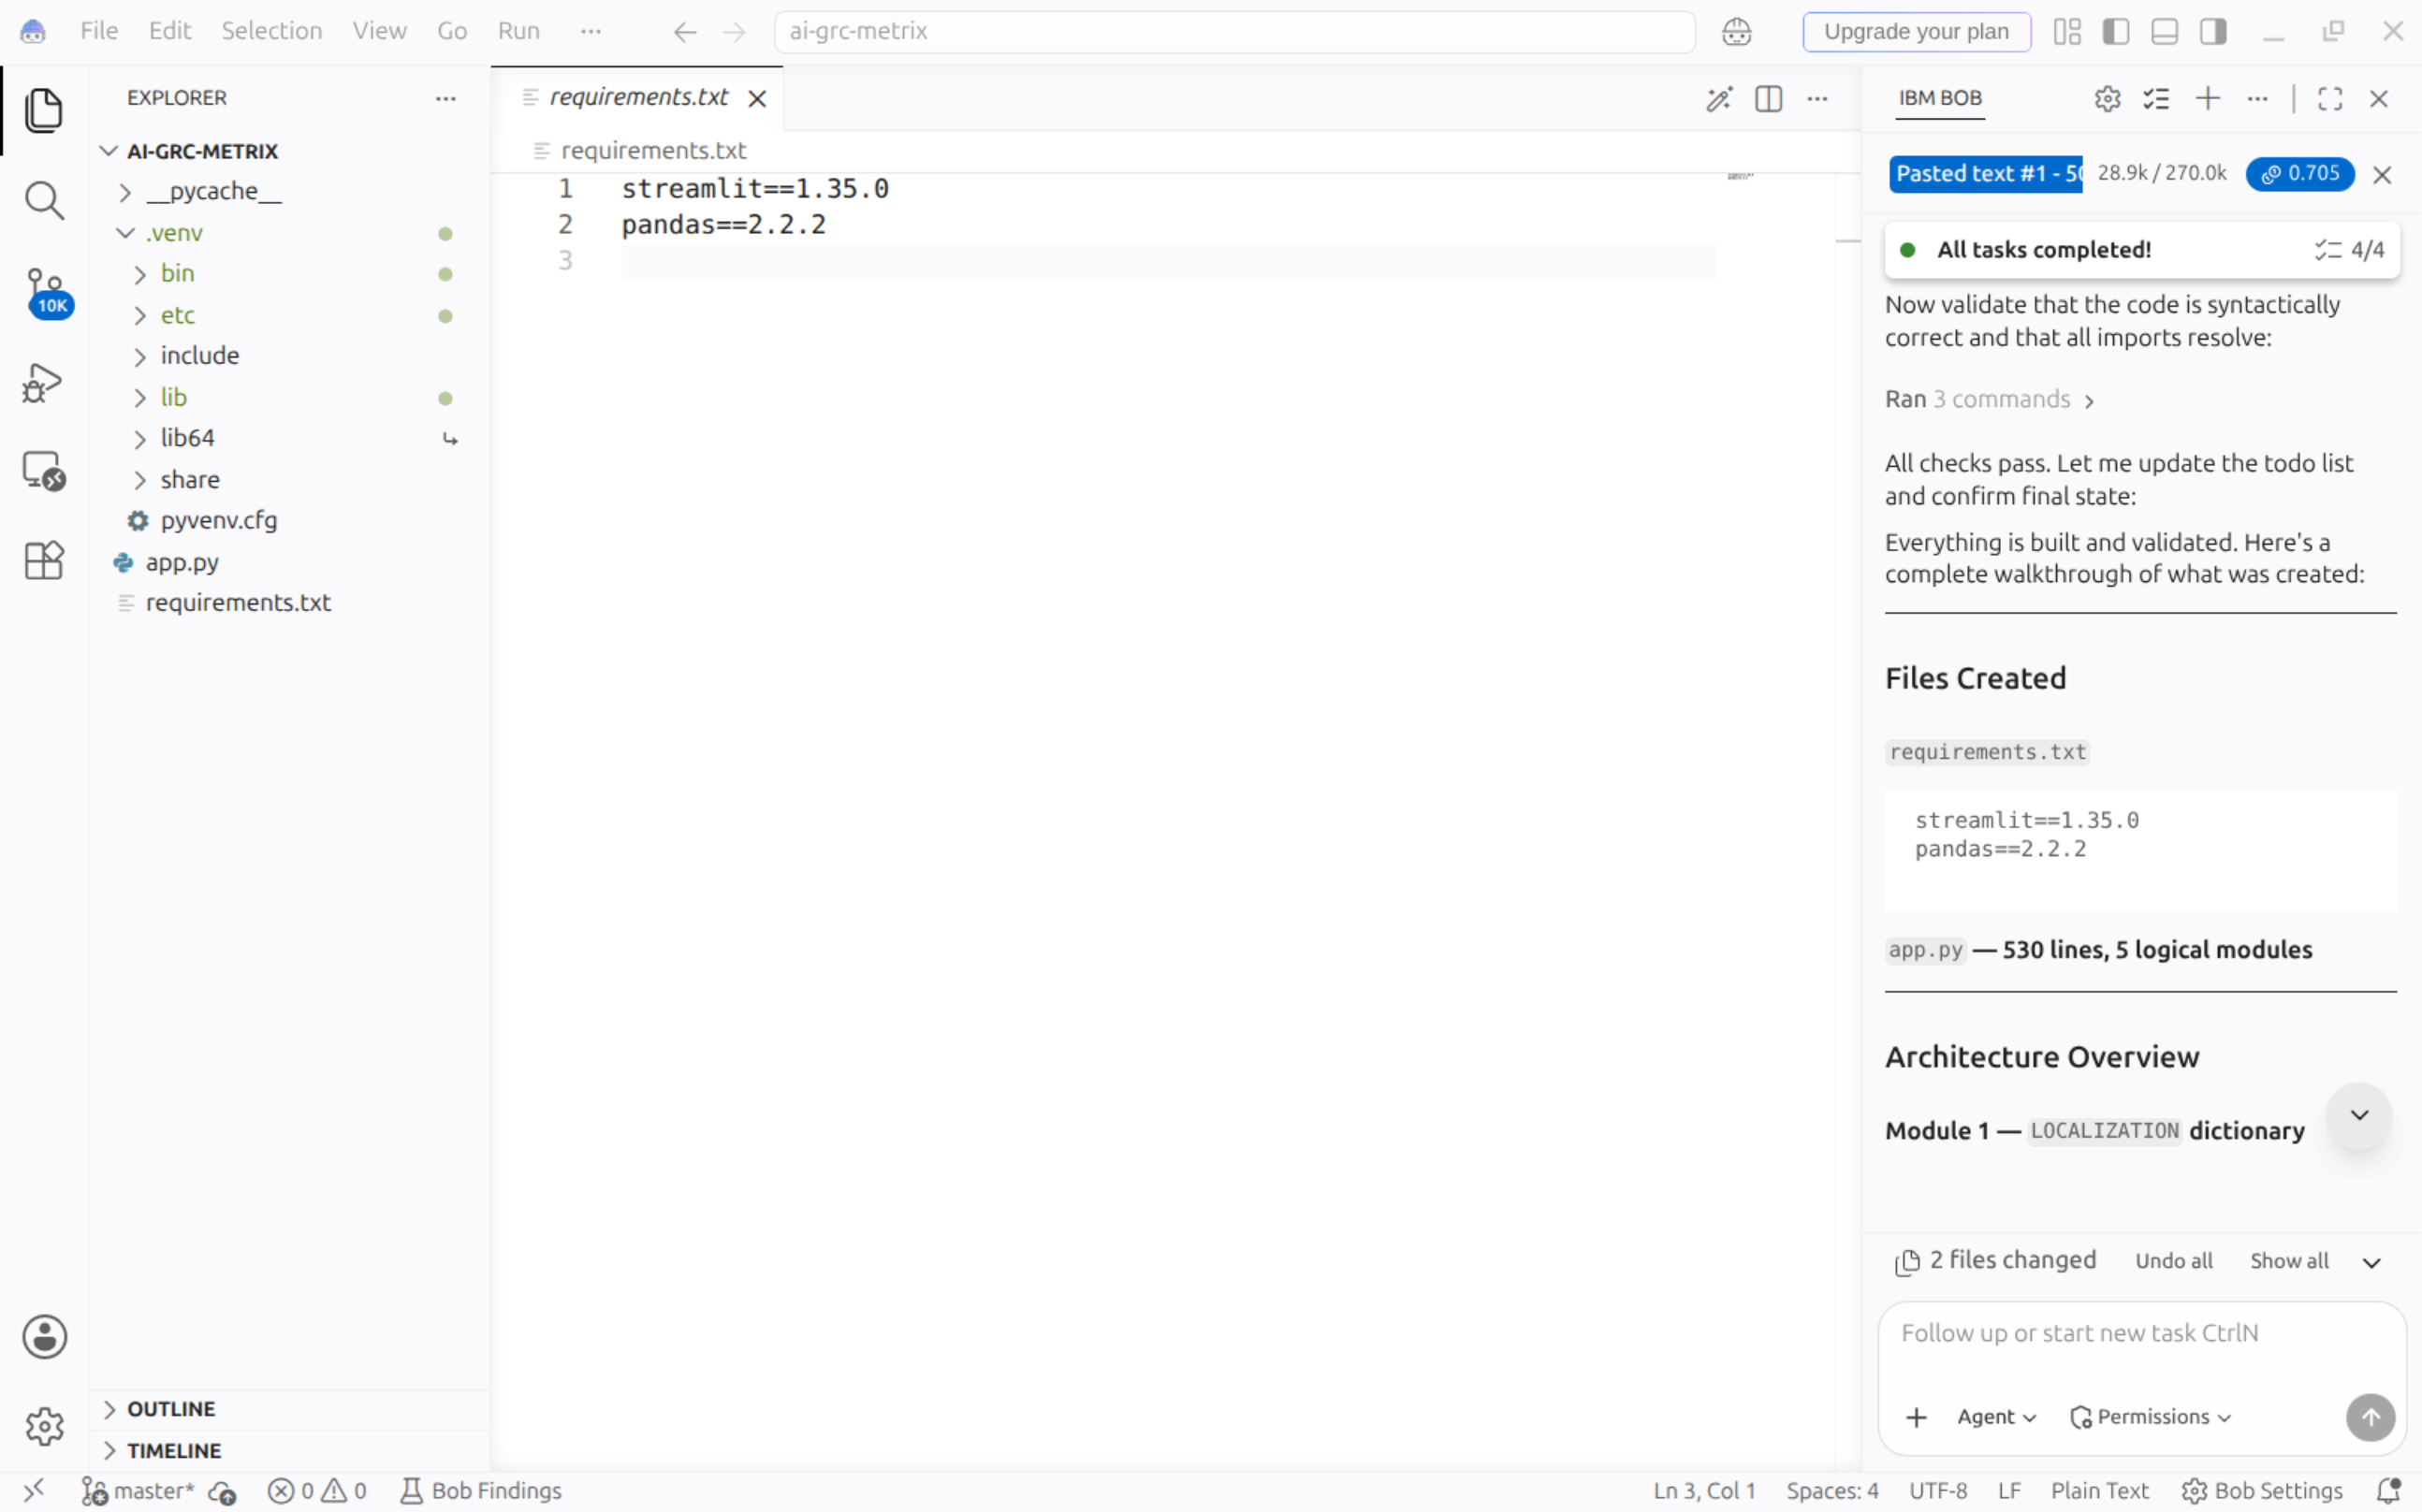
Result

Slide 10
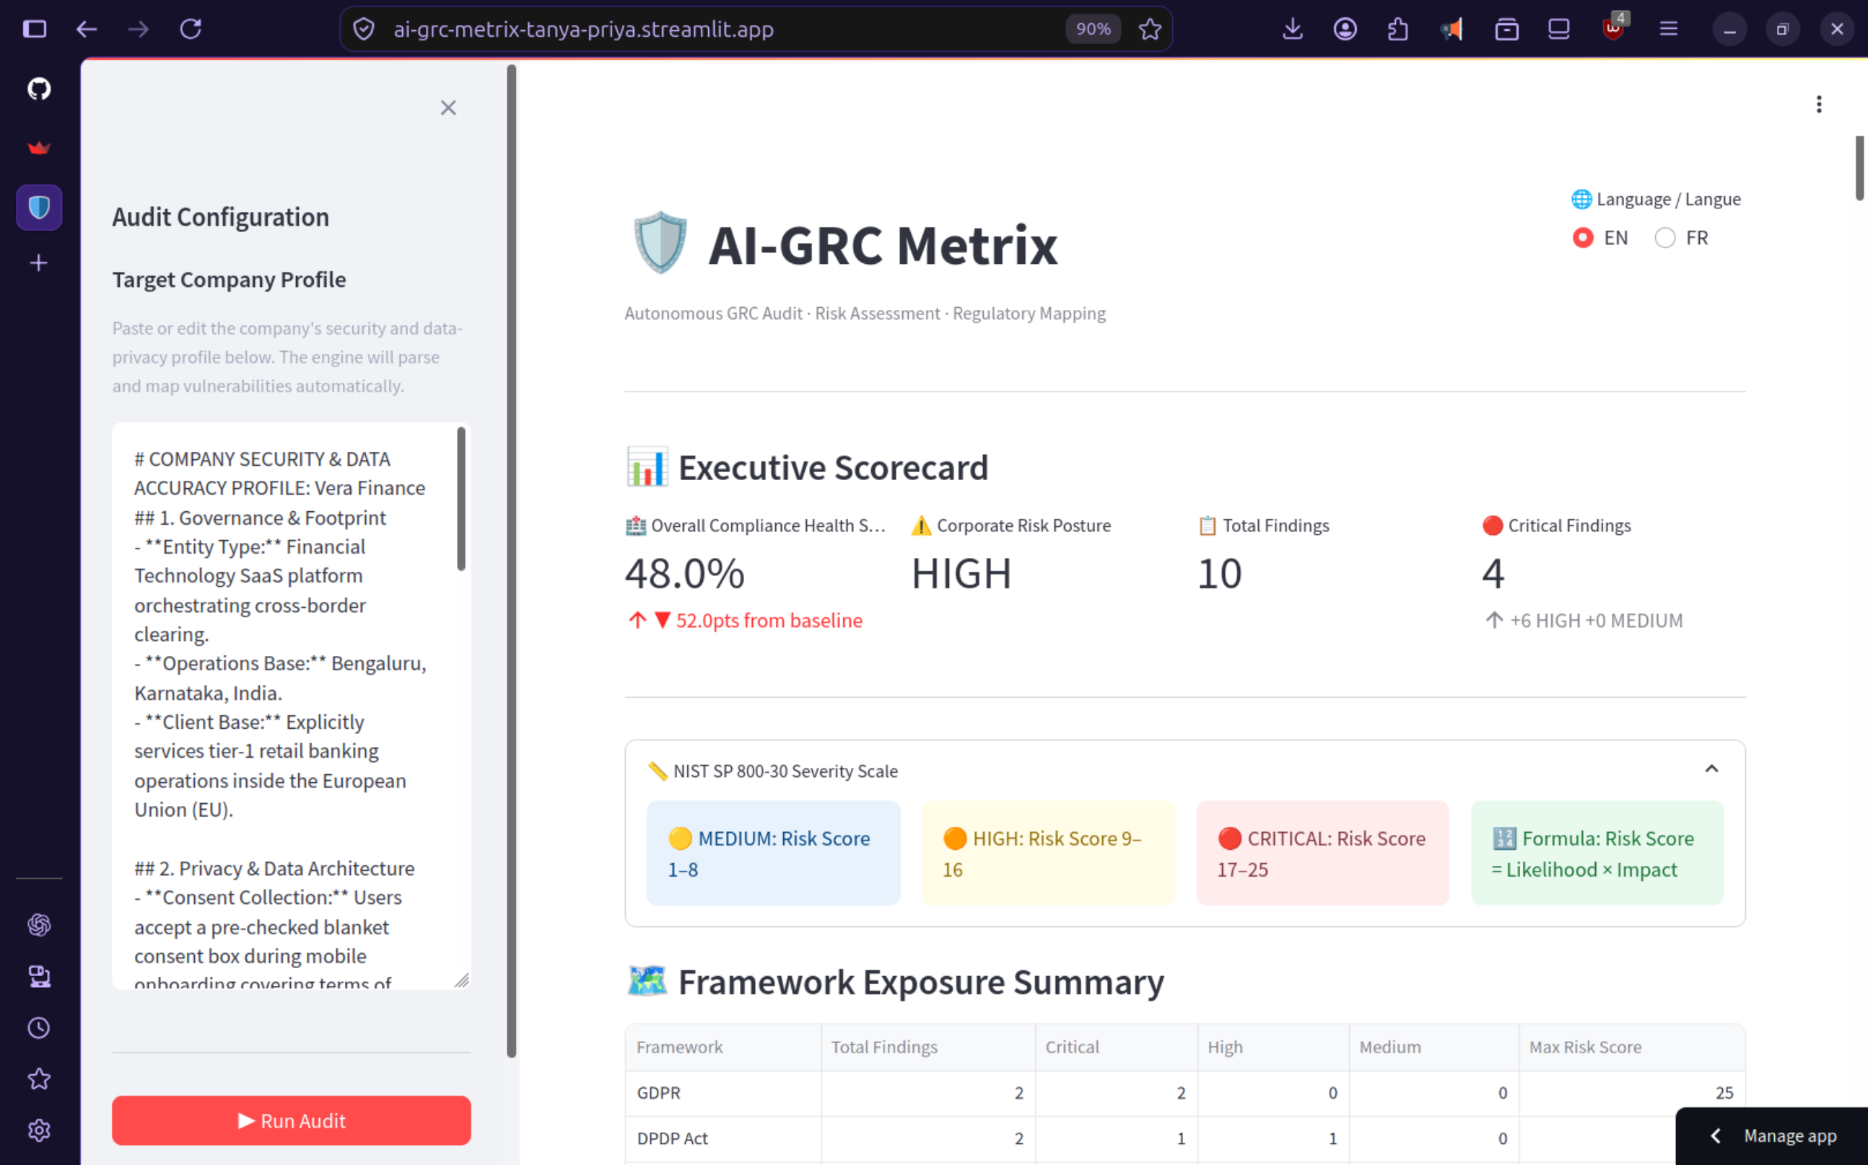
Result

Slide 11
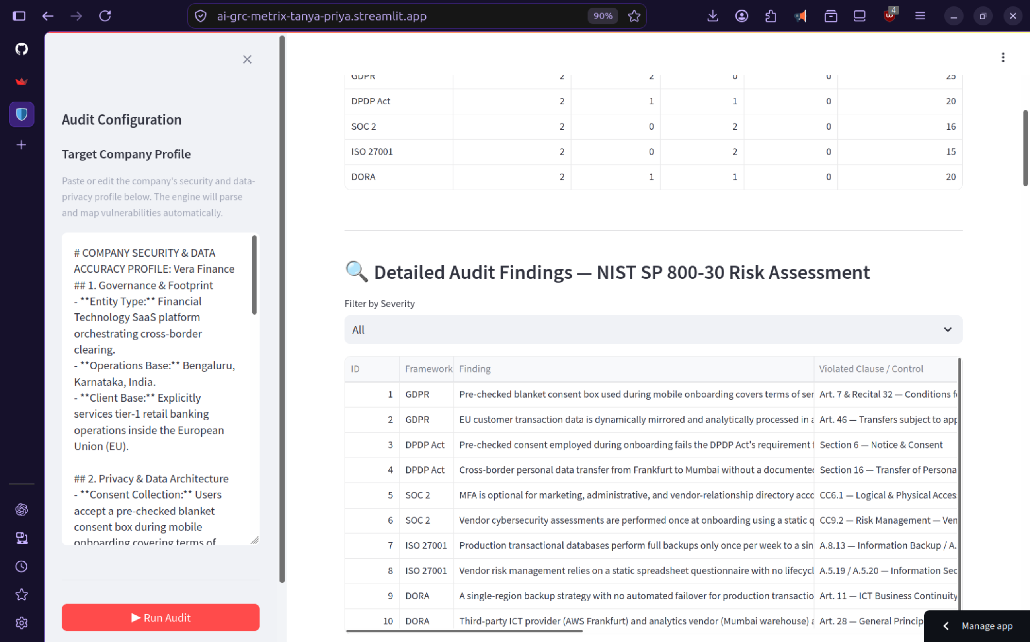
Result

Slide 12
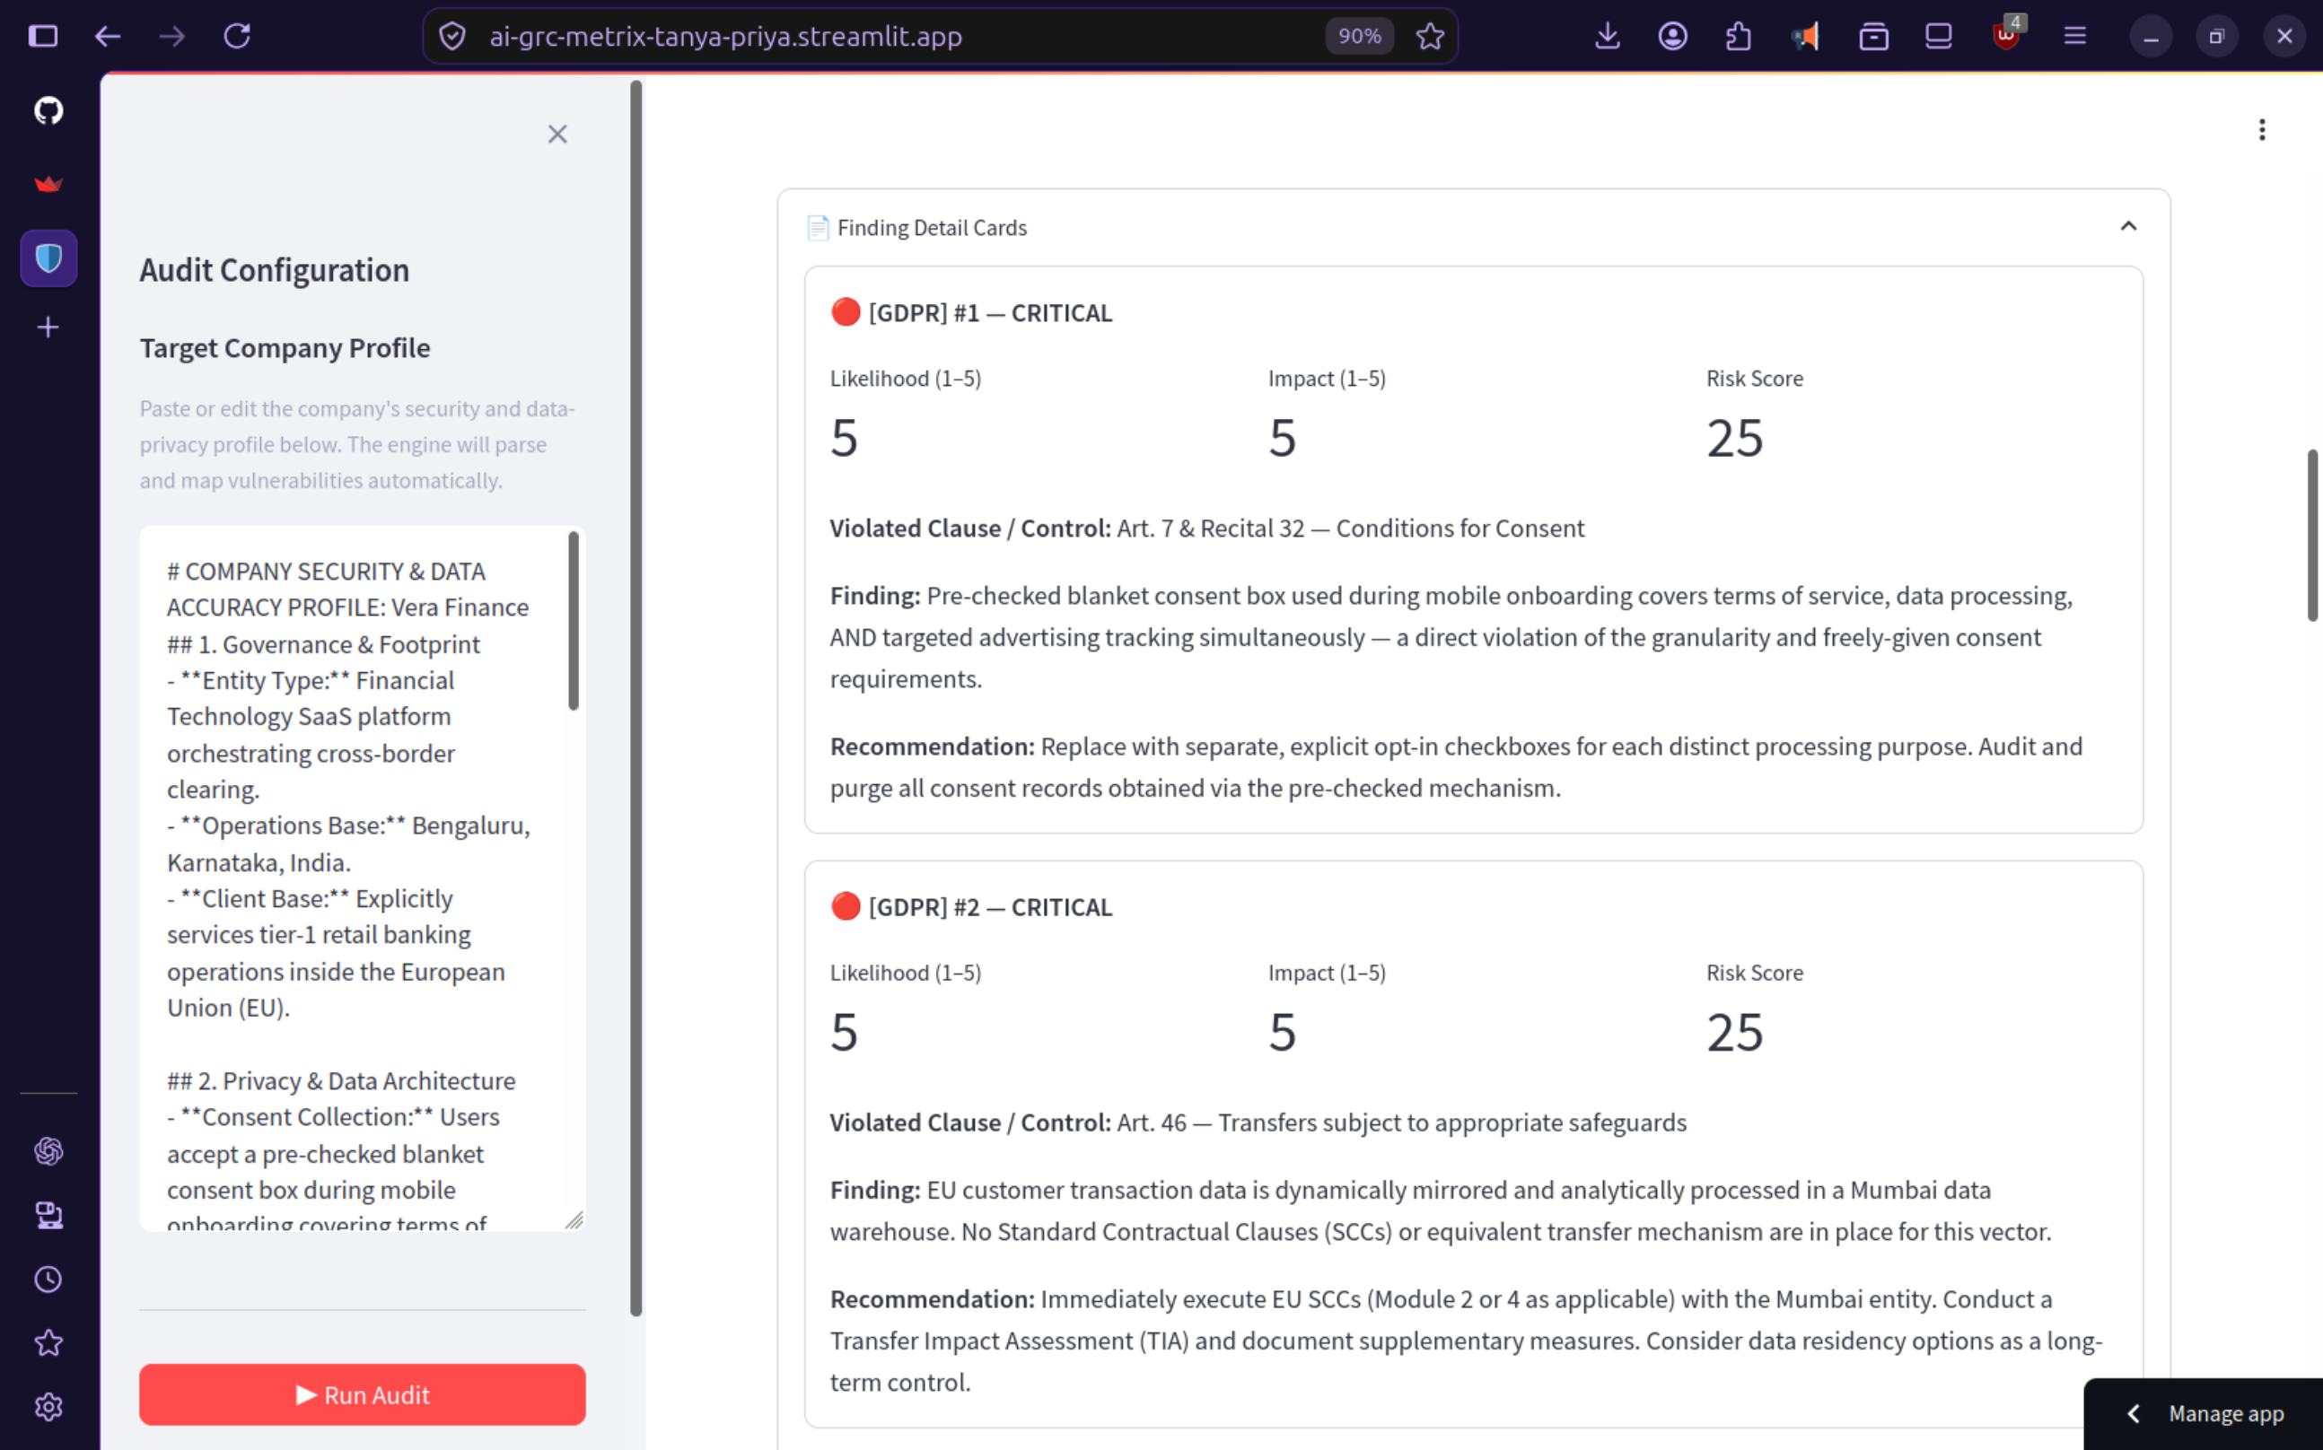
Result

Slide 13
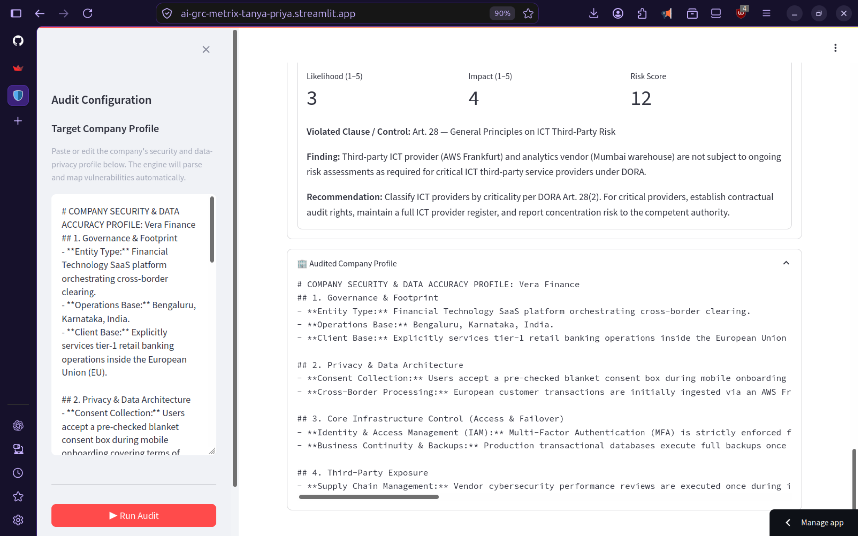
Result

Slide 14
Conclusion
AI-GRC Metrix shows how Generative AI can simplify GRC auditing by analyzing company information and identifying security, privacy, and compliance risks.
The system brings risk assessment and regulatory mapping into one place and presents the findings in a simple, understandable format.
It can help organizations identify important compliance gaps faster and focus on the areas that need attention.

Slide 15
Future scope
Add support for more GRC frameworks and regulations.
Improve analysis of uploaded documents and policies.
Add more detailed compliance and risk dashboards.
Improve risk recommendations using additional organizational context.
Integrate with existing enterprise GRC and security tools.

Slide 16
References
Google Gemini API Documentation - https://ai.google.dev/gemini-api/docs
Streamlit Documentation - https://docs.streamlit.io/
Python Documentation - https://docs.python.org/3.14/
NIST SP 800-30 – Guide for Conducting Risk Assessments - https://csrc.nist.gov/pubs/sp/800/30/r1/final
General Data Protection Regulation (GDPR) - https://gdpr-info.eu/
Digital Personal Data Protection Act (DPDP Act) - https://www.dpdpa.com/
SOC 2 - https://secureframe.com/hub/soc-2/compliance-documentation
ISO/IEC 27001 - https://www.iso.org/obp/ui/#iso:std:iso-iec:27001:ed-3:v1:en
Digital Operational Resilience Act (DORA) - https://www.eiopa.europa.eu/digital-operational-resilience-act-dora_en

Slide 17
Deployment link / github link
GitHub Repository Link : https://github.com/tanya-priya/ai-grc-metrix.git
Streamlit Live App Link : https://ai-grc-metrix-tanya-priya.streamlit.app/

Slide 18
THANK YOU

